Slide 1
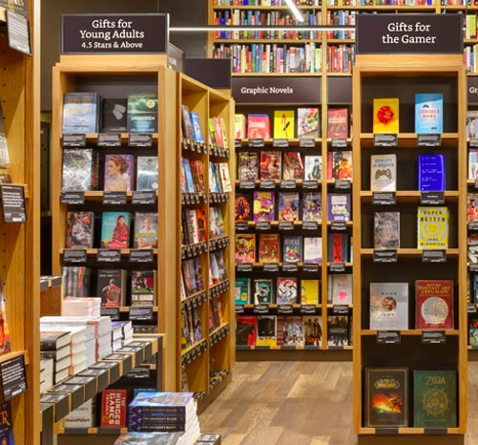
Online Categorical Reading System
Jingting Li,(jil206)
Junchao Mei, (jum68)
Yuqiang Wang(yuw99)

Slide 2

Agenda
Introduction
System Design outline
System Description
Retrieval Feedback Demo
Query & Feedback
Content Browse & search
Challenge

Slide 3
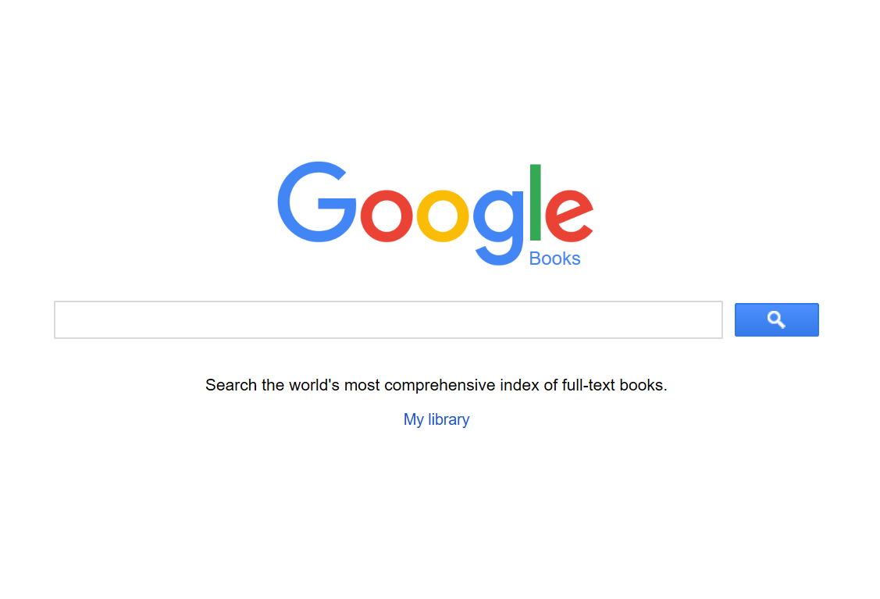
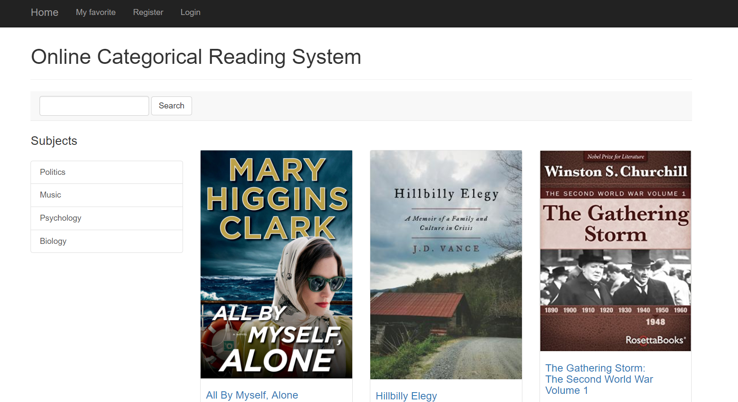
Introduction
IR system
Google API is a very powerful source we could take advantage of.
Our System (Online Categorical Reading)
Booking reading system with subject searching

Slide 4
System Design outline
Web page design
This graph basically show the structure of reading system.
Both searching can generate feedback to users, and aid customers finally obtain the result they want.
Read content
Searching by keywords
Searching by subjects
Short Feedback
Other function
Result(content)
Search in content

Slide 5
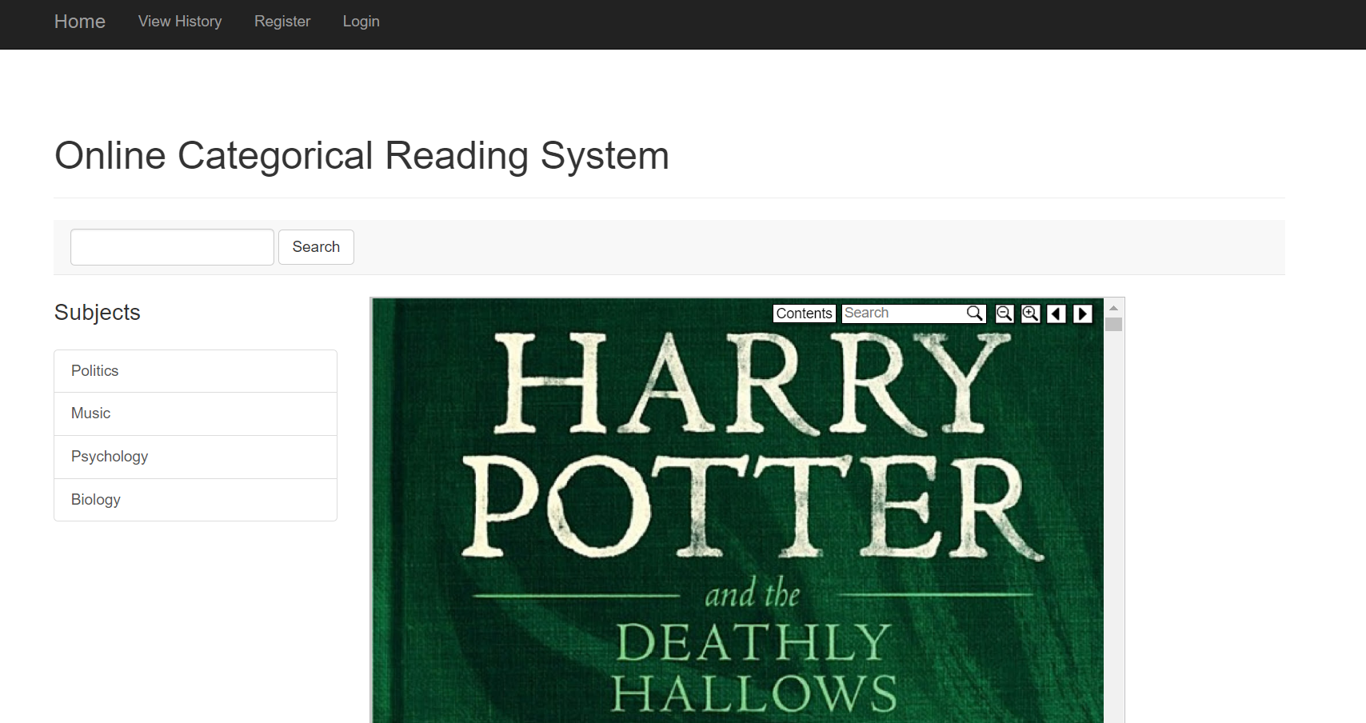
System description
Query search box
Search by subjects
Content view part

Slide 6
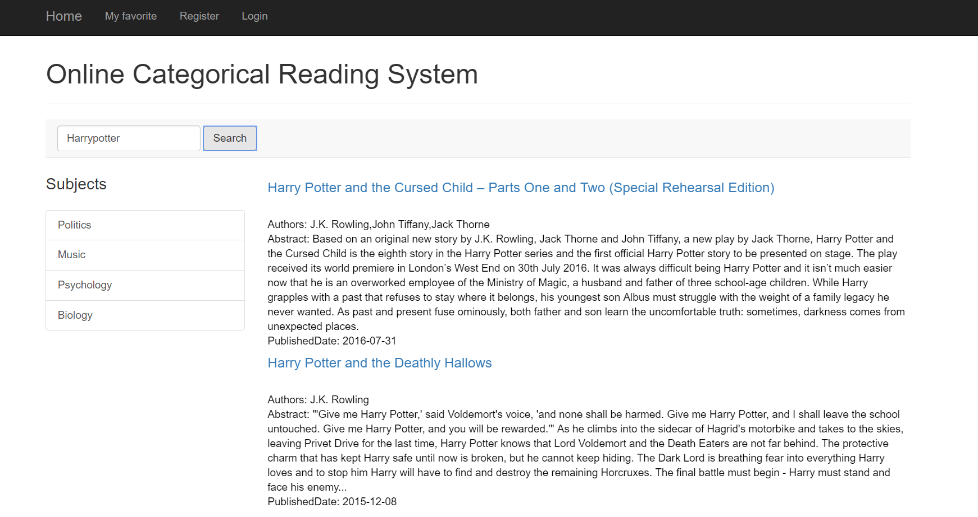
Retrieval Feedback Demo
When users type the keywords search engine will give relevant results with book name, author and abstract.

Slide 7
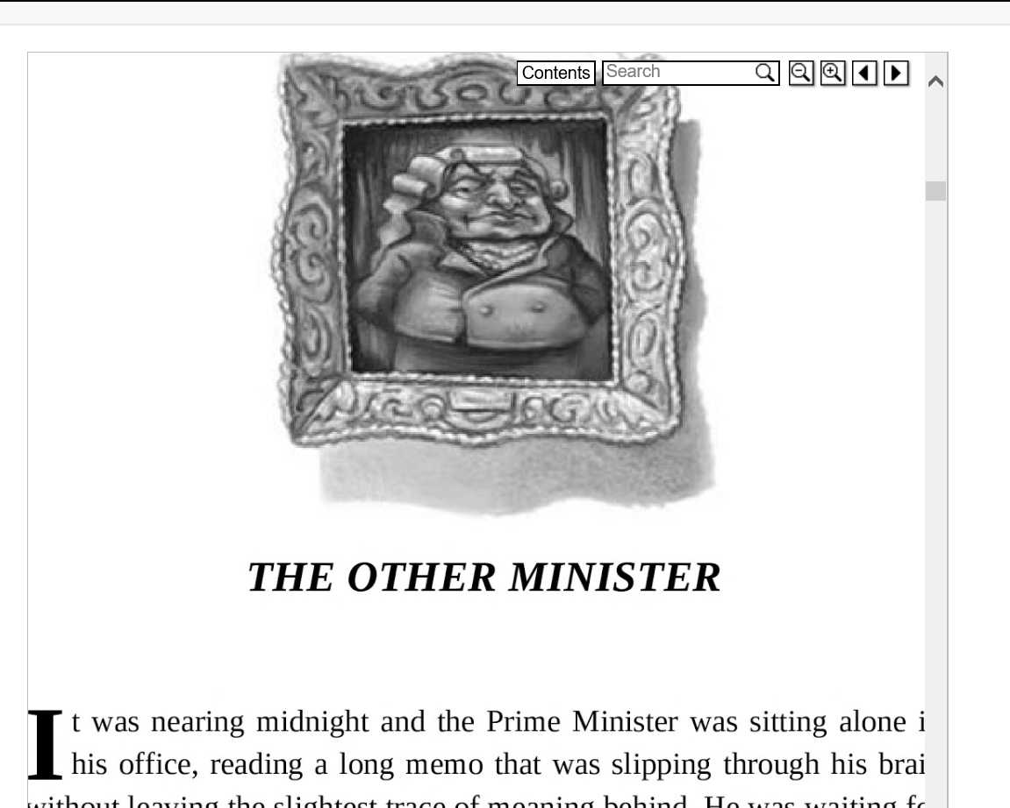
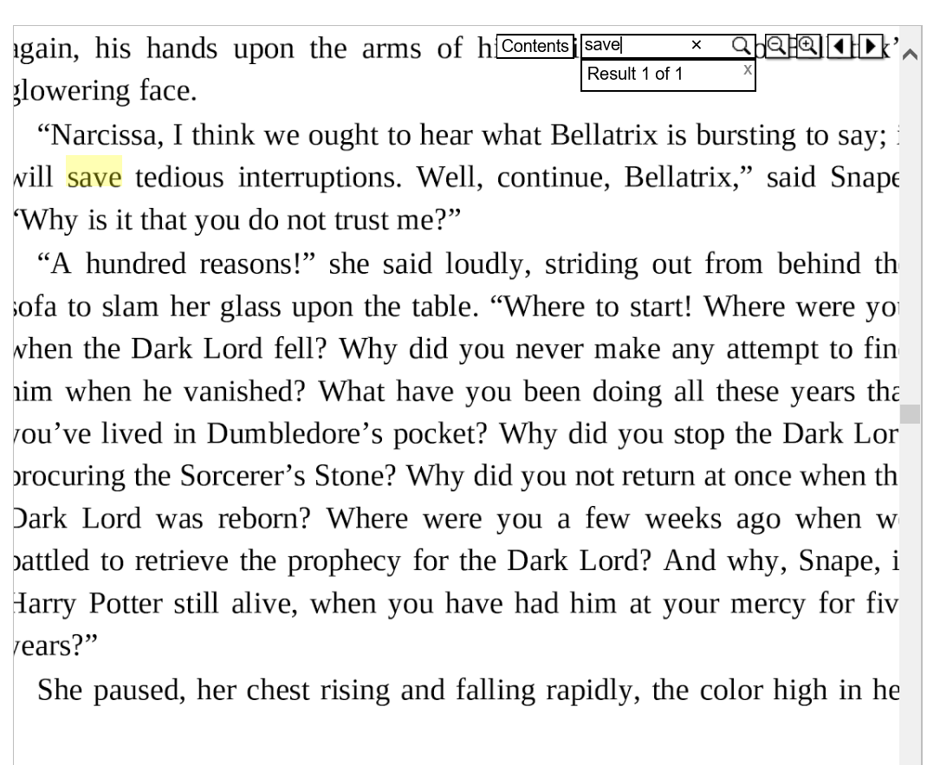
Content Browse & Search

Slide 8
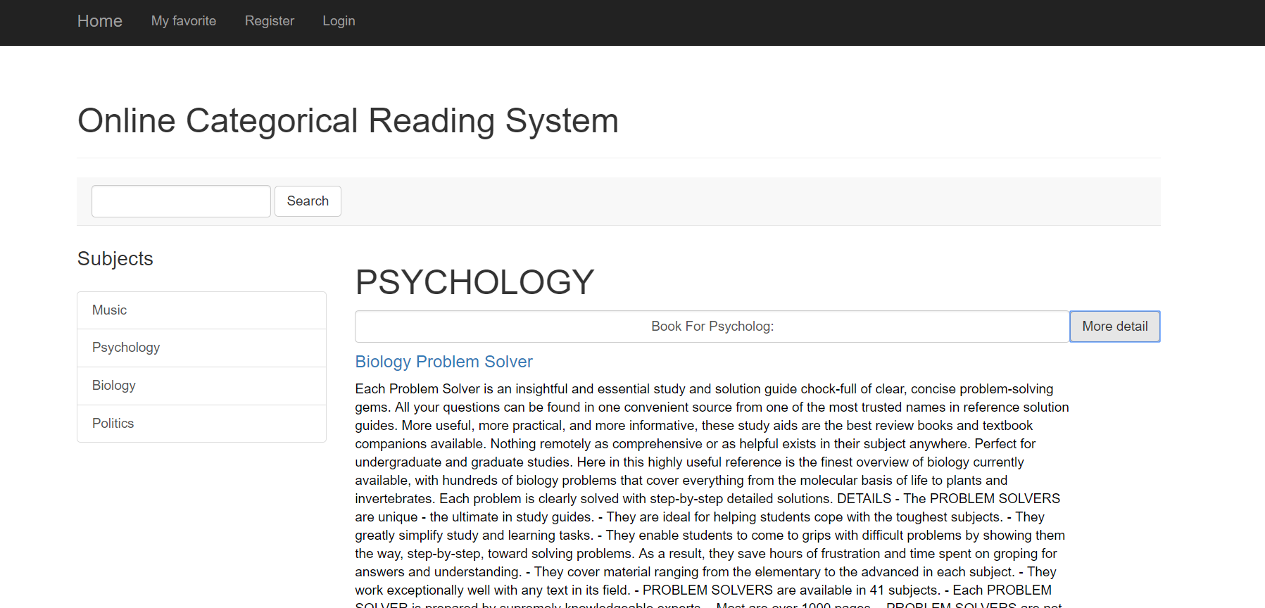
Retrieval Feedback Demo
Searching by subject is another way that users can query the book in their favorite domain. We built our inverted index and generate specific query model for each subject.

Slide 9
Query And Feedback
Book Title
Abstract
60,000
Document Model
Pre-processing
Subject2
(terms)
Subject1
(terms)
Manually collection+
Stemming+
Statistical language Model (Unigram)
Query Model
Subject3
(terms)
Subject4
(terms)

Slide 10


Challenge we faced
Works we need more:
Improvement of our interface. [Too simple to be attractive]
Less categories, lacking of variety
Improvement of efficiency. [It may take 1 or 2 min to retrieved the books in each category]
Store users information such as history searching and based on these information to do some recommendation.

Slide 11

Thank You!

